Slide 1

USGS DIGITAL TERRAIN MODELS AND MOSAICS FOR LMMP
M. R. Rosiek, E. M. Lee, E. T. Howington-Kraus, R. L. Fergason, L. A. Weller, D. M. Galuszka, B. L. Redding, O. H. Thomas, R. A. Saleh, J. O. Richie, J. R. Shinaman, B. A. Archinal, and T. M. Hare
U.S. Geological Survey
2255 N. Gemini Dr.
Flagstaff, AZ, 86001
mrosiek@usgs.gov spell out dtms
Notes:
I am not set on the colors so these may change

Slide 2
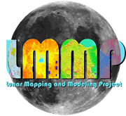
LMMP background
Lunar Precursor Robotic Program
Marshall Space Flight Center (LPRP/MSFC)
Tasked by the Advanced Capabilities Division
Results of LRO easily accessible and usable by the Constellation Program (CxP)
2007 – Lunar Mapping and Modeling Program (LMMP) start date
Goals for Lunar Mapping and Modeling Program (LMMP)
Develop and integrate a suite of lunar mapping and modeling tools and products to support CxP and other lunar exploration activities
Leverage products and expertise provided by the LRO Science Teams
Identify and leverage other areas where NASA has made investments in relevant activities and expertise
ARC, Arizona State University, CRREL (Army Cold Regions Research & Engineering Laboratory), GSFC, JPL, & USGS
Notes:
Back in 2007 the Lunar Precursor Robotic Program , located at Marshall Space Flight Center, was tasked by the Advanced Capabilities Division with support to the Constellation Program. This Program became know as the Lunar Modeling and Mapping Program. One of the goals of the program was to develop and integrate Lunar mapping and modeling tools and products to support the Constellation Program and other Lunar Exploration activities. This was leveraged of existing Programs and activities. The expertise within the Lunar Reconnaissance Orbiter Science Team and the data they produced provided a large contribution to the success of the Lunar Modeling and Mapping Program. There are other existing activities and expertise that were also leveraged. This is how the USGS became involved with the Lunar Mapping and Modeling Program.

Slide 3

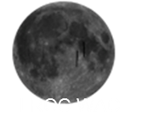
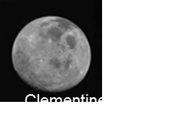

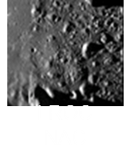
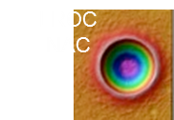
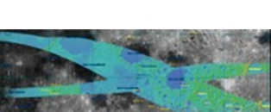
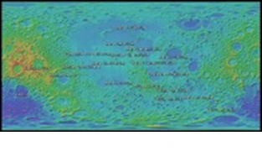
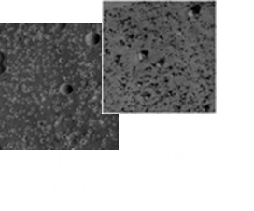
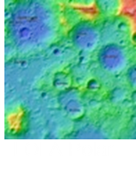
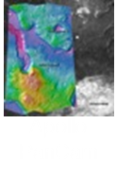
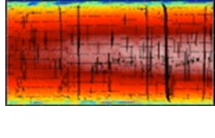
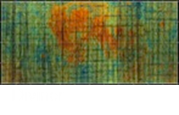
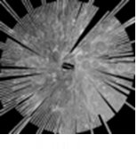
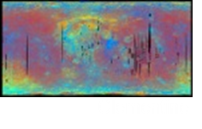
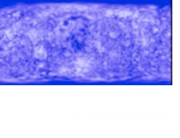
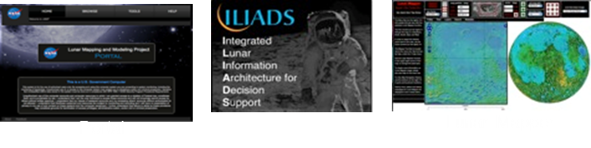
LMMP Products
Global, Regional and Local Scale Maps
Visible Imagery Base Maps
Topographic Maps
Surface Digital Elevation Models
Hazard Assessment Maps
Elevation Contour Maps
Lighting Maps
Temperature Maps
Gravity Models
Resource Maps
Other
Integrated Surface Visualization
Web-based & Desktop Clients
Format/Interface Standards
Extensibility
To other data products and other planetary bodies
Notes:
LMMP produced many products and DTMs and Mosaics are a part of that data
Mosaics and DTMs from Apollo panoramic camera ( 3 sites by USGS)
Mosaics and DTMs fro LRO NAC images ( 20 sites by USGS)

Slide 4
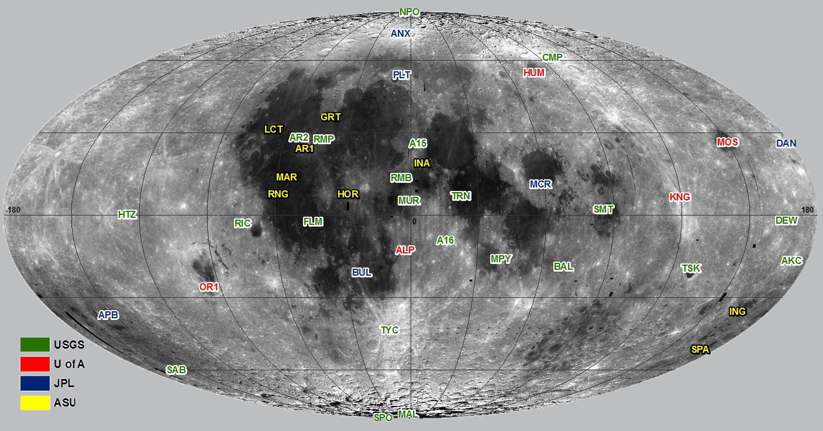
Constellation Regions of Interest
50 sites - selected
45 sites covered shown in image
2 polar regional mosaics - NPO and SPO on image
Possible future landing sites or representative terrain of future landing sites
Intended for engineering of Altair Lander, landing and surface operations simulations, actual landing navigation and surface operations

Slide 5
Source Material
LROC NAC images
LROC Science Operations Center
Smithed SPK SPICE kernels - LOLA team cross over
GSFC reconstructed SPICE data (CKs and SPKs)
Apollo Panoramic
Johnson Space Center → Arizona State University
Paris et al. abstract # 2273 – Thursday Poster
Controlled - ULCN 2005 and readjusted to the LOLA track data.
Image support data - National Space Science Data Center
LRO LOLA Reduced Data Records – March 2011 release
Tracks
Gridded data products
Notes:
Emphasize LOLA kernels were very useful

Slide 6
USGS Products
Site and regional products
23 DTMs covering 21 sites
Apollo Pan (3) and LROC NAC (20)
up to 40 x 40 km, 1.5 - 5 m post spacing (resolution)
0.028% of the Moon, 4.8 billion posts!
23 site mosaics covering 21 sites
Apollo Pan (3) and LROC NAC (20)
up to 40 x 40 km, 50-100 cm resolution
Controlled North and South Polar mosaics
from the pole to 85.5° latitude, 1 m resolution
Lee et al. abstract # 2507 - Thursday Poster

Slide 7
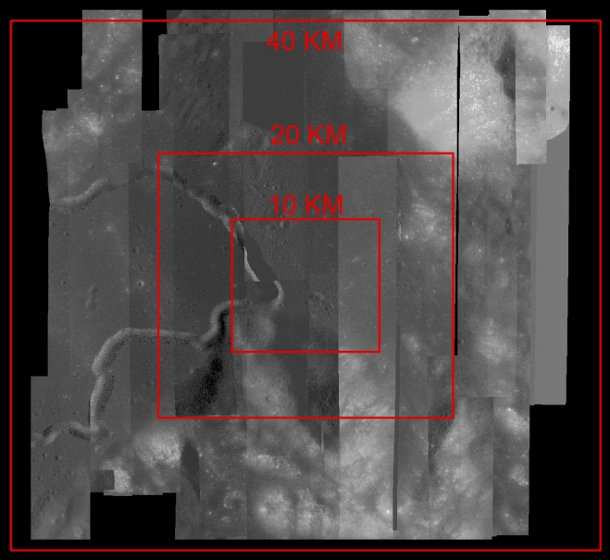
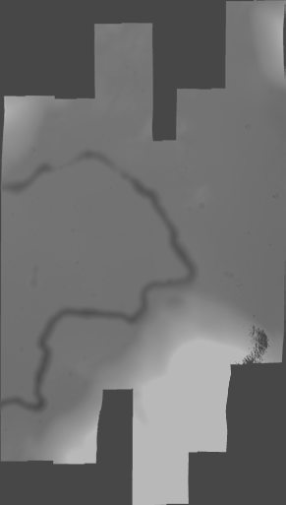
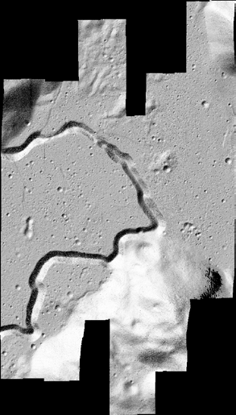
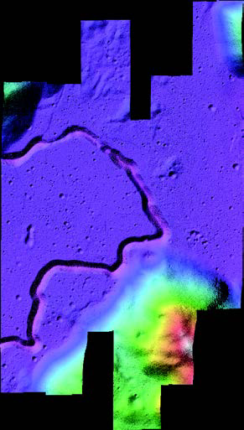
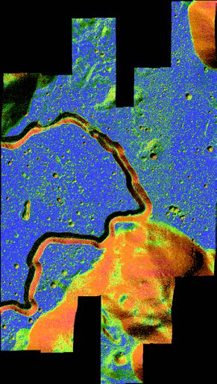
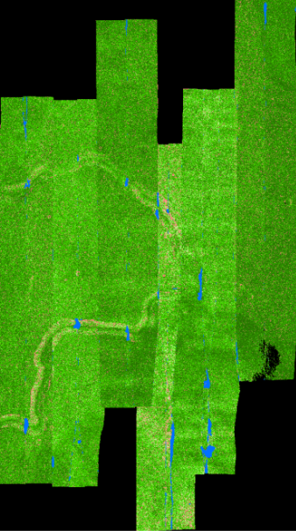


USGS Products – Apollo 15 site
Mosaic
DTM
Shaded Relief
Color Shaded Relief
Slope Map
Confidence Map

Slide 8
Validation process
Comparison to LOLA data
LRO NAC images triangulated to LOLA track points
Horizontal better than 20 - 30 m
LRO NAC DTMs compared to LOLA spot elevations
The average DTM has 95% of data within
Lower : -8.2 ± 3.4 m
Upper : +8.5 ± 3.8 m
LRO NAC Mosaics
ISIS 3 jigsaw results compared to SOCET SET triangulation
Control network checked for complete connections
Mosaic inspected for offsets between images
Mosaic compared LOLA DTM shaded relief images

Slide 9
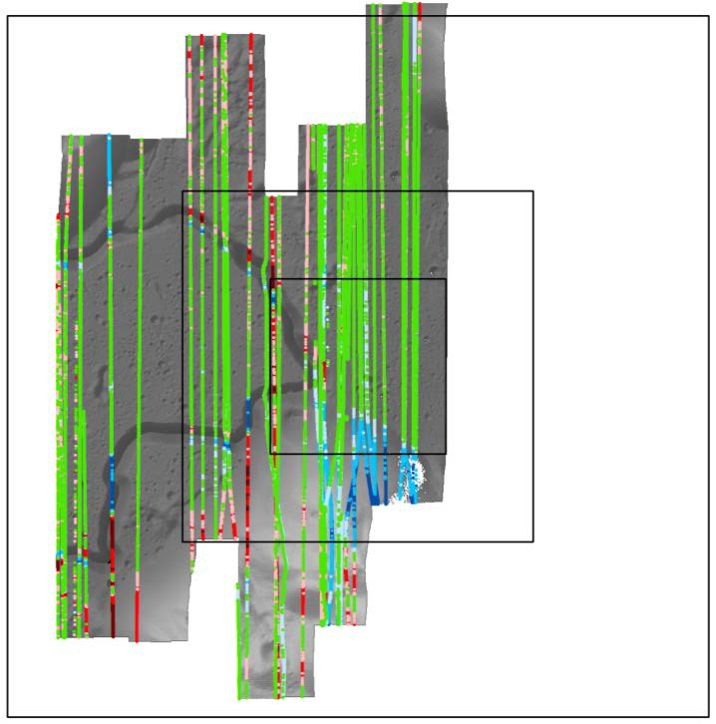
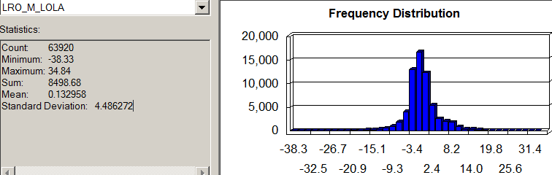
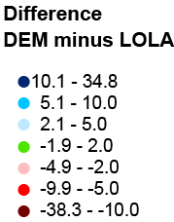
Validation process - DTMs
Comparison to LOLA spot elevations
40 KM
Mean | Std. Dev. | Max. | Min | # pts
0.1 m | 4.5 m | -38.3 m | 34.8 m | 63,920
20 KM
10 KM
95% range -9.5 to 10.6 m
10 x 10 km is 100% covered
20 x 20 km is 72.1% covered
40 x 40 km is 40.7% covered

Slide 10
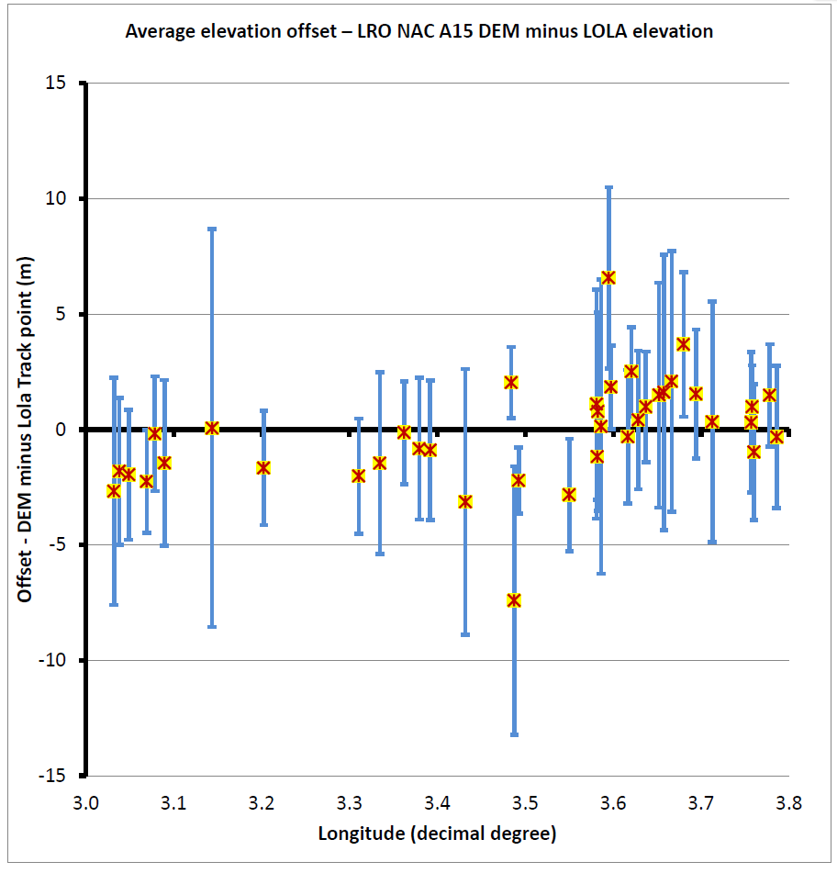
Validation process - DTMs
DTM elevation minus LOLA track elevation data
Offset in Tracks
±4.5 m
Standard Deviation
Tracks with large errors
10 x 10 km is 100% covered
20 x 20 km is 72.1% covered
40 x 40 km is 40.7% covered
10 x 10 km is 100% covered
20 x 20 km is 72.1% covered
40 x 40 km is 40.7% covered

Slide 11
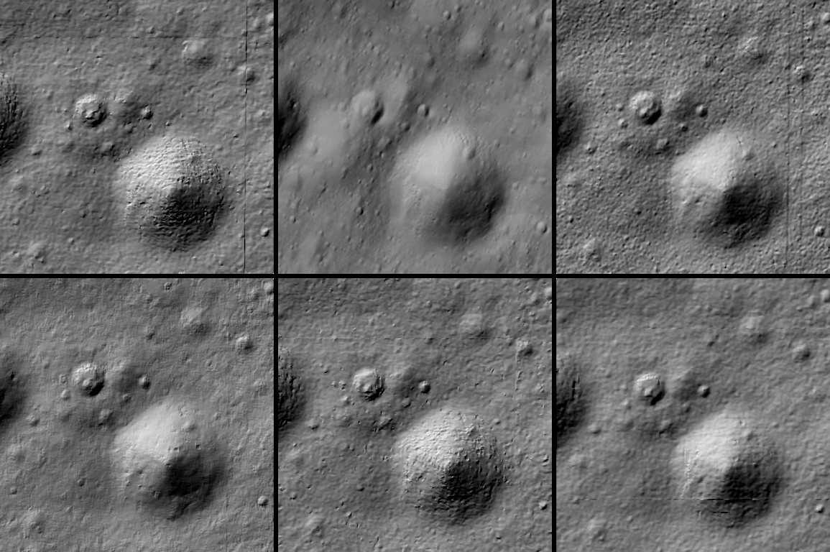
Validation - Across Teams
Arizona State University
JPL
German Aerospace Center
The Ohio State University
USGS
University of Arizona
Final results to be published
Beyer et al., 2011, 42nd LPSC # 1608
Beyer et al., 2010, 41st LPSC # 1533

Slide 12
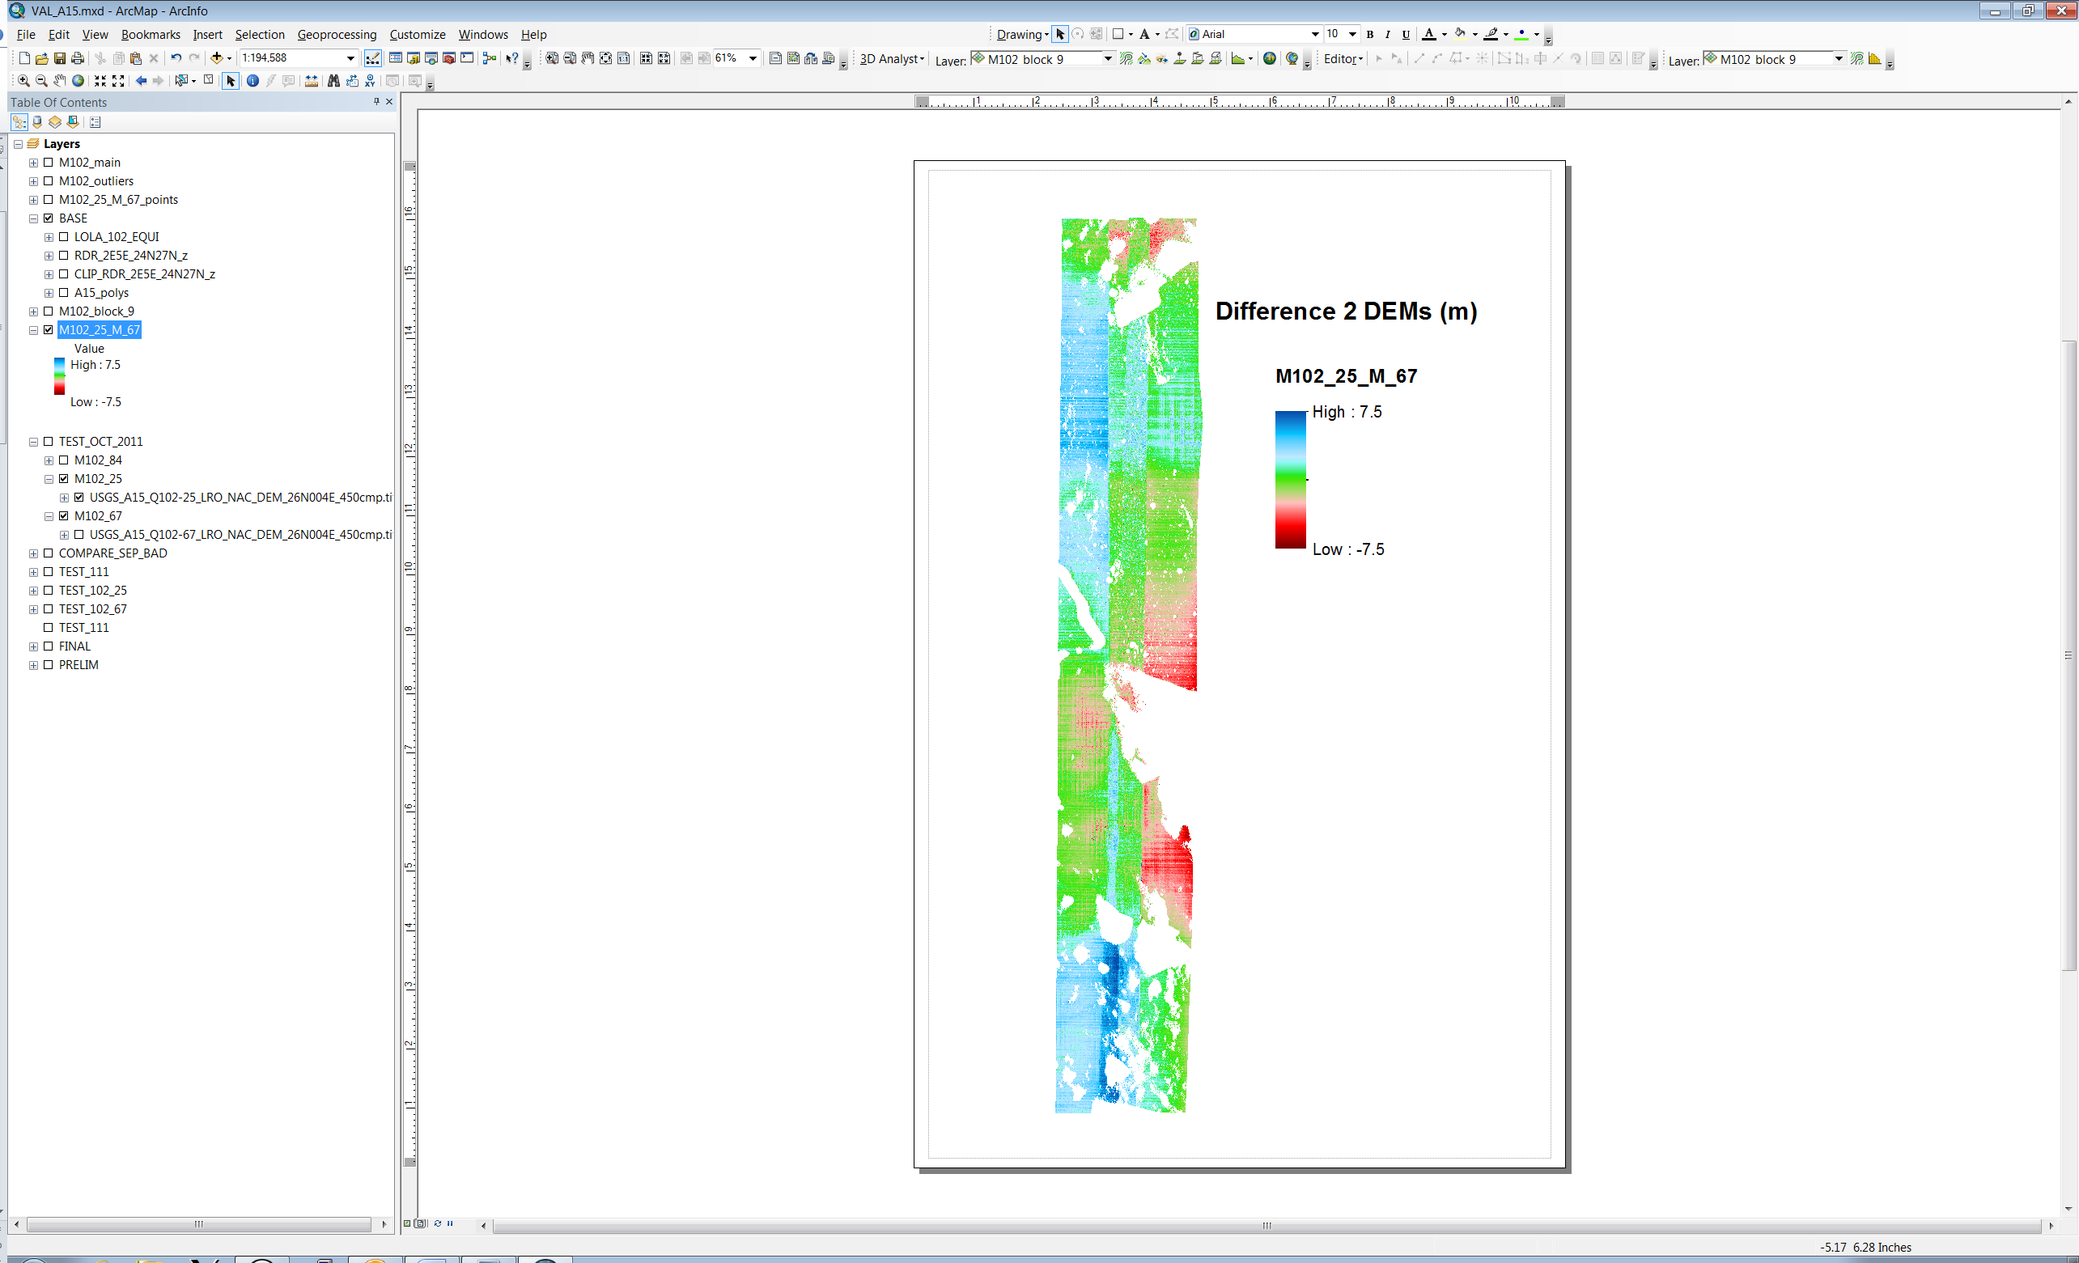
Validation - Apollo 15 Site USGS products only
DTM 1 - M102128467 and M102142784
DTM 2 - M102135625 and M102142784
Remove shadow areas
Early mission - images at higher altitude
Majority of differences within expected precision
Mean difference 1.1 m
standard deviation 2.5 m
95% range -3.3 to 6.2 m
1
2
3
N
Differences are not random
Structure related to stereo models
Might be related to unmodeled camera motion
Might be related to automatic correlation process

Slide 13
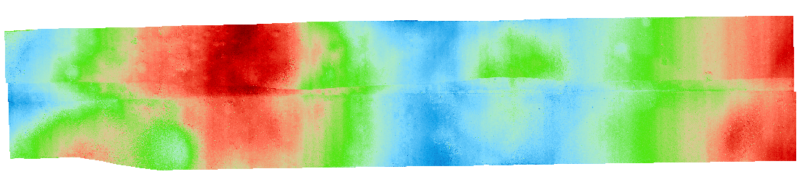

Validation - Tsiolkovskiy Crater Site USGS products only
Differences larger than expected precision
Mean difference -0.3 m
standard deviation 4.1 m
95% range –7.8 to 7.1 m
DTM 1 - M143778723 and M143785506
DTM 2 - M167363261 and M167370048
1
2
3
N
Differences are not random
Structure related to stereo models
Might be related to unmodeled camera motion

Slide 14
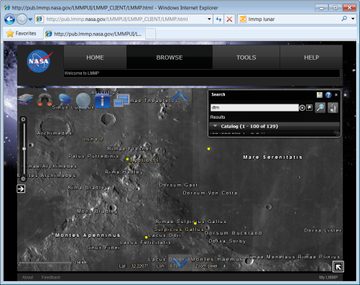
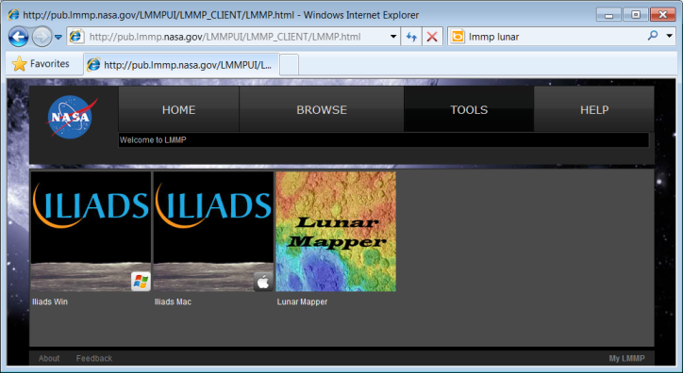
Summary - Products
Products available on LMMP Portal
http://lmmp.nasa.gov
Provides high resolution cartographic products
Mosaics – 0.5 to 1.0 m resolution
DTMs – 1.5 to 5.0 m resolution
Absolute Horizontal accuracy | better than 20 – 30 m
Absolute Vertical accuracy | better than 10 m

